Slide 1


Target Market:- People on a budget or on vacation who want to utilize products temporarily for their needs.
Team Members:-
1. Pulkit Khursija
2. Anil Kumar
3. Sri Santhi
4. Praveen Pindi
5. Shiva Reddy
Value propositions:-
Easily renting anything and everything from your neighborhood. An idea that will help to reduce the purchase of occasionally use products.

Slide 2

Addressing the Pain:-
From simple tasks like fixing our own automobile or cutting our own grass to complex 3D printing projects, we need lots of tools and machinery.
Also, when on vacation, people need to buy temporary items like vehicles, equipment, tents, etc. to make their stay more comfortable.
If one person have a tool/product that they rarely use and another have the same, they would exchange or trade their goods, finish their task, then return them.

Slide 3

Fixing the problem:-
A website where the renter and the leaser can meet, talk, and strike a deal for renting things over the website.
This solution will maximize the efficiency of a resource(in this case a product) and will also generate income to the owners for items that collect dust in their homes.
The website will also have the ability to filter out products based on the proximity.
The idea will provide owners to rent out products that they don’t use often or have spares of some products. While it will also be beneficial for someone who is searching for some products but requires it for only a short period of time.

Slide 4

Conceptuation and Justification:-
The fundamental idea is to bring two persons (renter & leaser) together to share resources and make money.
In terms of application, our website is similar to Facebook's marketplace and an Indian website named OLX(sell used products), but our website is different in its applicability (rent products )
There are thousands of products and items which after some time collect dust at our warehouses, which our website make use of those products.
The app creates a bridge between such people and helps a person rent an item that is unwanted for someone else.

Slide 5

Market Research:-
As per our research on the subject there is no direct competitor for the application. However, there are some websites and applications that rent out cars and property.
There is actually no known website or apps that rent you products this small and directly from the owner.
We would be practically be competing with no one because this idea has been intended to make space for itself.
Websites that rent you property or houses do not let you deal directly with the owner, rather acts as an intermediate between the two increasing the cost of renting.

Slide 6

Target Market & Value Propositions:-
Our target market are the customers who are unable to afford certain things that are required in their day to day life by providing a platform to rent those items.
Our value propositions include
Renting based on the products proximity.
Easily renting anything and everything from your neighborhood.
An idea that will help reduce the purchase of occasionally use products.

Slide 7

Business model & Making money:-
Affordability is our target market. Renters of goods.
Our website makes money from subscriptions. It includes three categories
Free (contains ads and postings have no priority)
Premium(giving the user priority so that their product is featured first when a user searches for that category)
Ultra(merchants that already lease out products in their stores)

Slide 8

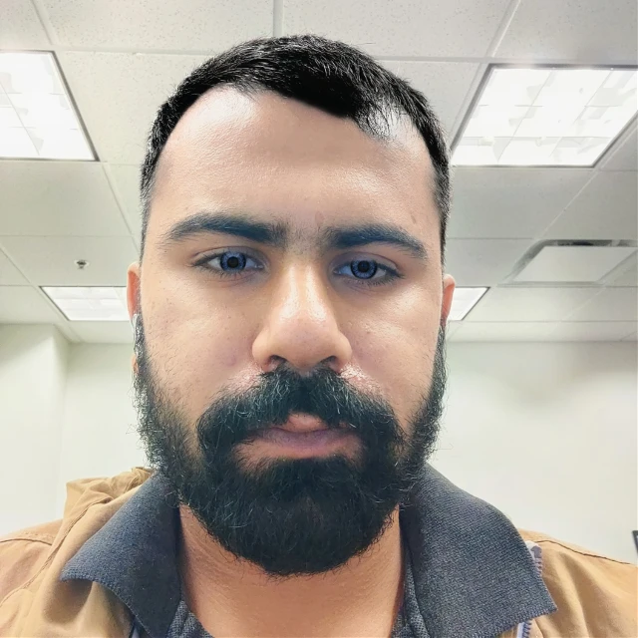




Team Member Expertise and Contributions :-
Expertise in technology, coding and finds innovative solutions to any problems.
Deals with business related issues and performs design.
Deals with creative designing and implementation of effective procedures.
PULKIT KHURSIJA
SRI SANTHI
SHIVA REDDY
Deals perfectly with the relations, perform managerial activities and helps in team collaboration.
Deals with asset acquiring and to maintain a constant flow of development.
ANIL KUMAR
PRAVEEN

Slide 9
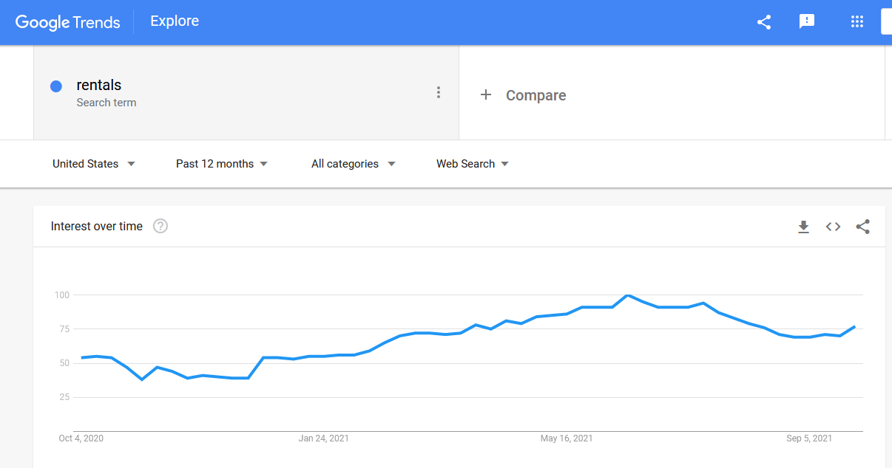
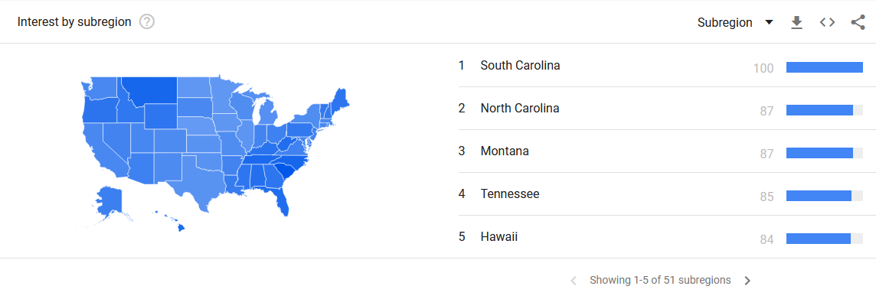
Why EzRent?
It is a single place for all your rental needs.
Helps renter to earn without actually putting in efforts as side/ main income. Will act as a side income for many.
Help leaser in getting basic item with out actually buying the product.Will reduce the waste as people will be using an item more than what it is being used now for.
Will help increase the quality of items in the market.
It is one of the pioneers in the rental market.
There is definitely a need of more rental items specially for one time use items.
Rental items are cheaper and better than second hand or used items.

Slide 10





Communication efforts:-
WhatsApp
Facebook
Teams
WebEx
Git Hub

Slide 11

Thank You
Suggestions and Questions are appreciated

